Slide 1

AIESEC Digital Transformation Presentation
Caner Irfanoglu
Diven Kumar Sambhwani Sunil Padikar M Vinay Govindan
5th Quartile
Notes:
Darkened picture background with full-color circle
(Intermediate)
Tip: For best results with the picture overlay on this slide, use a picture that is the same dimensions as the slide: 10” wide and 7.5” high. If the picture is not the same width and height, resize or crop to those dimensions before following the instructions below.
To reproduce the background effects on this slide, do the following:
On the Home tab, in the Slides group, click Layout, and then click Blank.
Right-click the slide and then click Format Background.
In the Format Background dialog box, click Fill in the left pane. In the Fill pane, select Picture or texture fill, and then under Insert from, click File.
In the Insert Picture dialog box, select a picture, and then click Insert.
Also in the Format Background dialog box, click Picture in the left pane, and then do the following in the Picture pane:
Click the button next to Recolor, and then under Color Modes, click Grayscale (first option from the left).
In the Brightness box, enter -50%.
In the Contrast box, enter -60%.
On the Insert tab, in the Images group, click Picture.
In the Insert Picture dialog box, select the same picture used for the background, and then click Insert.
On the Home tab, in the Drawing group, click Shape Effects, point to Soft Edges, and then click 10 Point.
Under Picture Tools, on the Format tab, in the Size group, click the down arrow under Crop, click Crop to Shape, and then under Basic Shapes, click Oval (first row, first option from the left).
Select the oval. Under Picture Tools, on the Format tab, in the bottom right corner of the Size group, click the Size and Position dialog box launcher. In the Size and Position dialog box, on the Size tab, under Crop from, enter values into the Left, Right, Top, and Bottom boxes to crop the oval as needed.

Slide 2

Problem Statement

Slide 3
Applicant & Opportunity Trend
During recent years # of opportunities & applicants increased

Slide 4


Grouping Opportunities
Recency
(weeks)
Oldest | 0.50 | 1.02 | 486
Old & Not Popular | 1.36 | 1.09 | 264
Extreme # Applicants | 191.30 | 14.71 | 118
New & Not Popular | 5.84 | 37.81 | 67
Newest & Not Popular | 4.98 | 10.08 | 53
# Applications
# Opening
Five groups (clusters) represent all opportunities
Newest & Not Popular and New & Not Popular groups show the most potential for betterment

Slide 5
Application Distribution
55%
Opportunities has no applicants

Slide 6
Current Recommender Observations
Prioritizes organization
Countries suggested randomly
Skill and Background only match exactly
Not favoring least applied opportunities

Slide 7

The Recommendation System

Slide 8
Analytical Hierarchy Process (AHP)
Simple technique used for tuning contribution of parameters
Country, Skill & Background parameters used for ranking
Multiplied with popularity factor for final rating

Slide 9
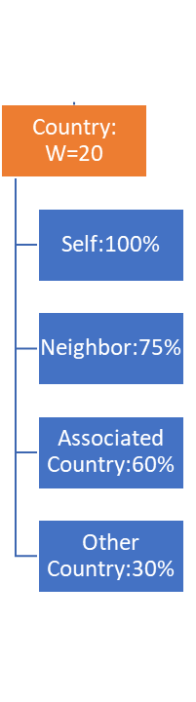



AHP Structure
Finding Similar countries
Step 1
Finding Similar Interest Countries
Get the ratio of applicants
per opening
Ranking Position
Country: W=20
Skill: W=40
Background: W=40
Self:100%
Skill 1:(40/n)
Skill 2:(40/n)
Skill n:(40/n)
Background 1:(40/n)
Background 2:(40/n)
Background n:(40/n)
Step 3
Neighbor:75%
Self:100%
Self:100%
Self:100%
Self:100%
Self:100%
Self:100%
Order the results
Step 2
Popularity Factor
Rating
Associated Country:60%
Associate 1:80%
Associate 1:80%
Associate 1:80%
Associate 1:80%
Associate 1:80%
Associate 1:80%
Calculate the average for each country
Other Country:30%
Associate 2:75%
Associate 2:75%
Associate 2:75%
Associate 2:75%
Associate 2:75%
Associate 2:75%
Associate 3:70%
Associate 3:70%
Associate 3:70%
Associate 3:70%
Associate 3:70%
Associate 3:70%

Slide 10
Assign Country Score
Max: 20
Selection : Taiwan
Rating Opportunities
Opportunity Id
Country
Relationship
%
Score
1
Taiwan
100
20
1
Taiwan
Self
100
20
Self
China
Neighbour
75
15
2
China
Neighbour
75
15
2
3
Chile
Associate
60
12
3
Chile
Associate
60
12
4
30
6
4
Brazil
30
6
Brazil
No Relationship
No Relationship

Slide 11
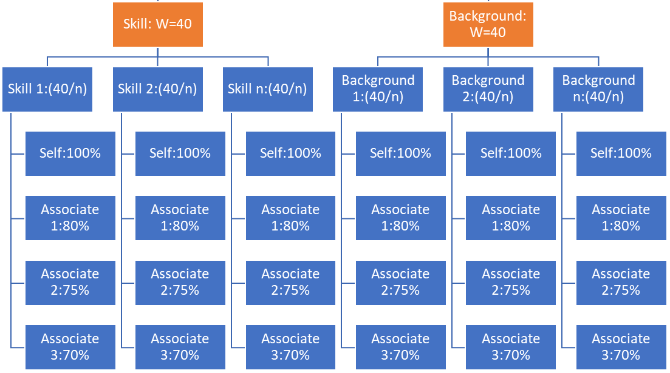
AHP Structure
Ranking Position
Country: W=20
Skill: W=40
Background: W=40
Self:100%
Skill 1:(40/n)
Skill 2:(40/n)
Skill n:(40/n)
Background 1:(40/n)
Background 2:(40/n)
Background n:(40/n)
Neighbor:75%
Self:100%
Self:100%
Self:100%
Self:100%
Self:100%
Self:100%
Popularity Factor
Rating
Associated Country:60%
Associate 1:80%
Associate 1:80%
Associate 1:80%
Associate 1:80%
Associate 1:80%
Associate 1:80%
Other Country:30%
Associate 2:75%
Associate 2:75%
Associate 2:75%
Associate 2:75%
Associate 2:75%
Associate 2:75%
Associate 3:70%
Associate 3:70%
Associate 3:70%
Associate 3:70%
Associate 3:70%
Associate 3:70%

Slide 12
Association Mining
MS PowerPoint
MS Word
MS Excel
Google Drive
Sports
Arts
Theatre
Music
Technique used for Market-Basket Analysis
Provided relevant Skill, Background & Language Information

Slide 13
Assign Background and Skill Score
Max: 40
x2
Background Selection: Music
Rating Opportunities
Opportunity Id
Background
Relationship
%
Score
1
40
1
Music
100
40
Music
Self
100
Self
Theatre
80
32
2
Theatre
Associate - 1
80
32
2
Associate - 1
3
Arts
75
30
3
Arts
Associate - 2
75
30
Associate - 2
4
Associate - 3
70
28
4
Sports
Associate - 3
70
28
Sports

Slide 14
AHP Structure
Applicants per Opening
Ranking Position
Obtained by dividing # applicants to openings
Used for penalizing high attention opportunities
Multiplier is assigned based on levels of measure
Country: W=20
Skill: W=40
Background: W=40
Popularity Factor
Self:100%
Skill 1:(40/n)
Skill 2:(40/n)
Skill n:(40/n)
Background 1:(40/n)
Background 2:(40/n)
Background n:(40/n)
Neighbor:75%
Self:100%
Self:100%
Self:100%
Self:100%
Self:100%
Self:100%
Popularity Factor
Popularity Factor
Rating
Associated Country:60%
Associate 1:80%
Associate 1:80%
Associate 1:80%
Associate 1:80%
Associate 1:80%
Associate 1:80%
Other Country:30%
Associate 2:75%
Associate 2:75%
Associate 2:75%
Associate 2:75%
Associate 2:75%
Associate 2:75%
Associate 3:70%
Associate 3:70%
Associate 3:70%
Associate 3:70%
Associate 3:70%
Associate 3:70%

Slide 15
Assign Multiplier Factor
Max: 1.00
Rating Opportunities
Opportunity Id
# of Applicants
# of Openings
App / Openings
Multiplier
1
197
601
1.00
1
197
601
0.33
1.00
0.33
0.85
2
105
60
1.75
0.85
2
105
60
1.75
3.8
3
10
3.8
0.80
3
38
10
0.80
38
4
4
0.70
14
1
14
0.70
14
1
14

Slide 16
Hat

Slide 17


Slide 18

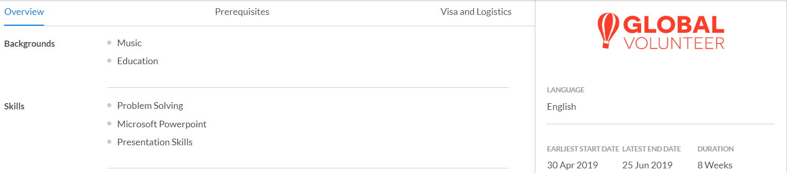

Slide 19
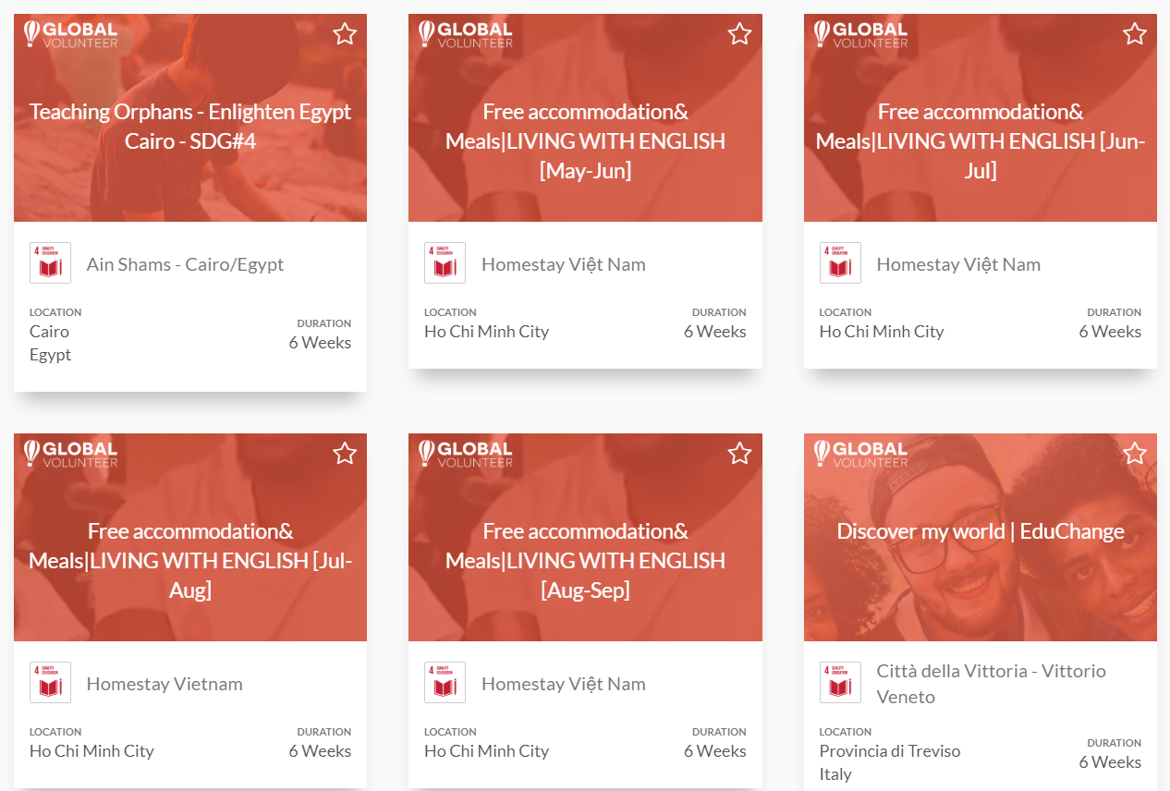
Backgrounds
Communication & Journalism
Marketing
Skills
Team Management
Facilitation
Presentation Skills
Leadership
Language Teaching
0 Match
1 Match(s)
Country : Taiwan Background : Education, Music Skills : Microsoft PowerPoint, Presentation skills, Problem Solving
Selection:

Slide 20
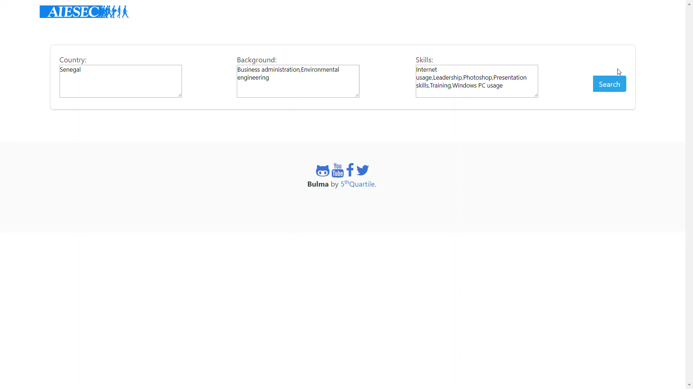

Slide 21


Benchmark – Results
23%
60%
Skill + Background
Match
5th
Skill + Background
Match
87% with Associates

Slide 22
Feasibility, Conclusion & Future Work

Slide 23




Feasibility
Flexible and easily scalable
Integration only requires database access

Slide 24
Conclusion & Future Work
Recommendation systems contribute at least by 66% and on average by 336% to revenues (Dias et al., 2008)
Potential for discovering thousands of hidden opportunities
Can be expanded to opportunity searches in future

Slide 25
Thank you for listening

Slide 26
Prototype Link
http://lnx.cs.smu.ca:5000/

Slide 27
Benchmark – Calculation
Max: 12
Max: 18
Max: 30
Background
Skill
Total
AIESEC
2
5
AIESEC
2
5
7
7
10
8
18
Proposed System - Exact
10
8
18
Proposed System - Exact
Proposed System – Associate
8
Proposed System – Associate
2
6
8
2
6

